Slide 1
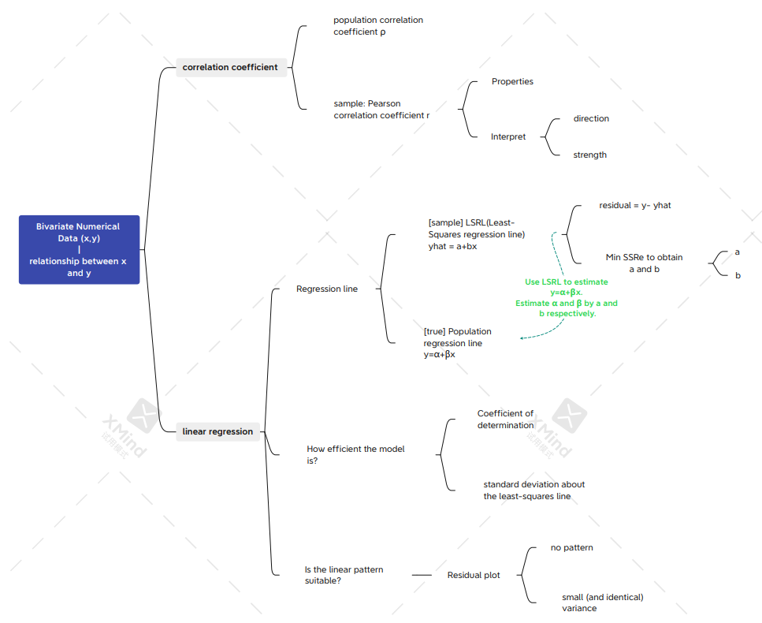
Review

Slide 2
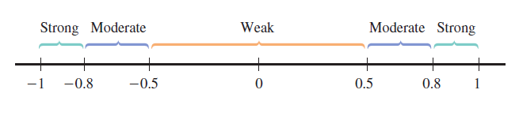
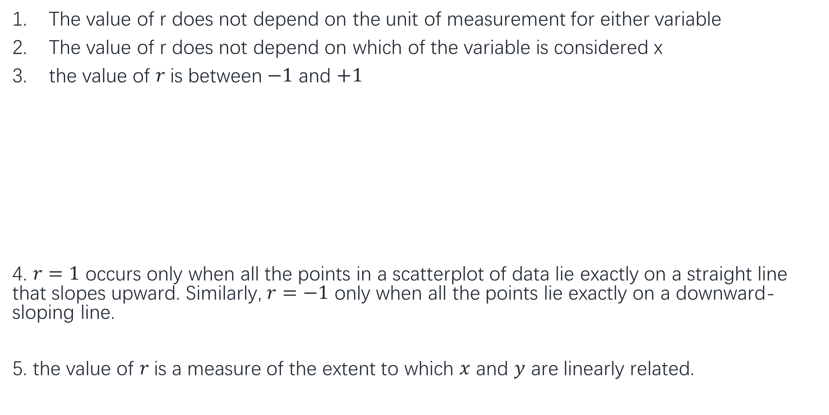
Properties of r
The value of r does not depend on the unit of measurement for either variable
The value of r does not depend on which of the variable is considered x
the value of $r$is between $−1$ and $+1$
4. $r=1$ occurs only when all the points in a scatterplot of data lie exactly on a straight line that slopes upward. Similarly, $r=−1$ only when all the points lie exactly on a downward-sloping line.
5. the value of $r$is a measure of the extent to which $x$ and $y$ are linearly related.

Slide 3
Extrapolation
In prediction, we need to pay attention that the least-squares line should not be used to predict the value of y outside the range of x values in the data set, because we do not know whether the linear pattern observed in the scatter plot continues outside the range. This is sometimes referred to as the danger of extrapolation.

Slide 4
Outlier: A point with a large residual (but its x value is normal). Outlier fall far away from the regression line in the y direction.
Influential observation: A point with x value differs greatly from the rest of the data, and removal of the point has a large impact on the value of the slope or intercept of the regression line. Influential point fall far away from the rest of the data in the x direction

Slide 5
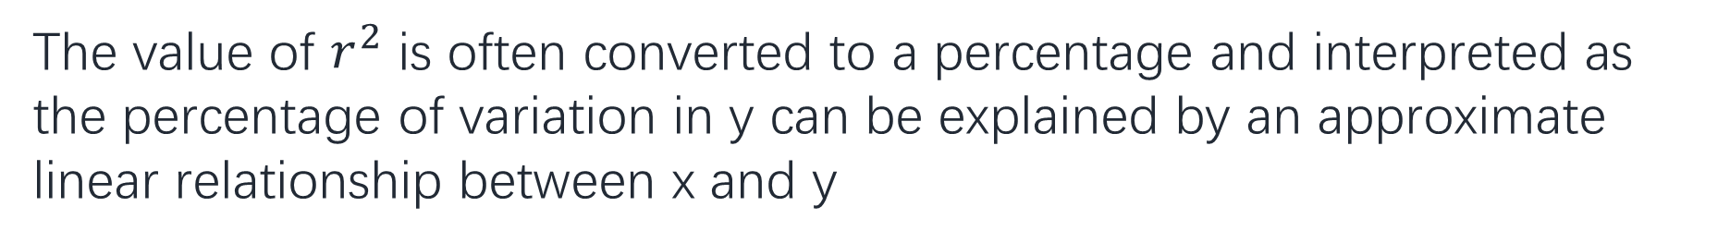
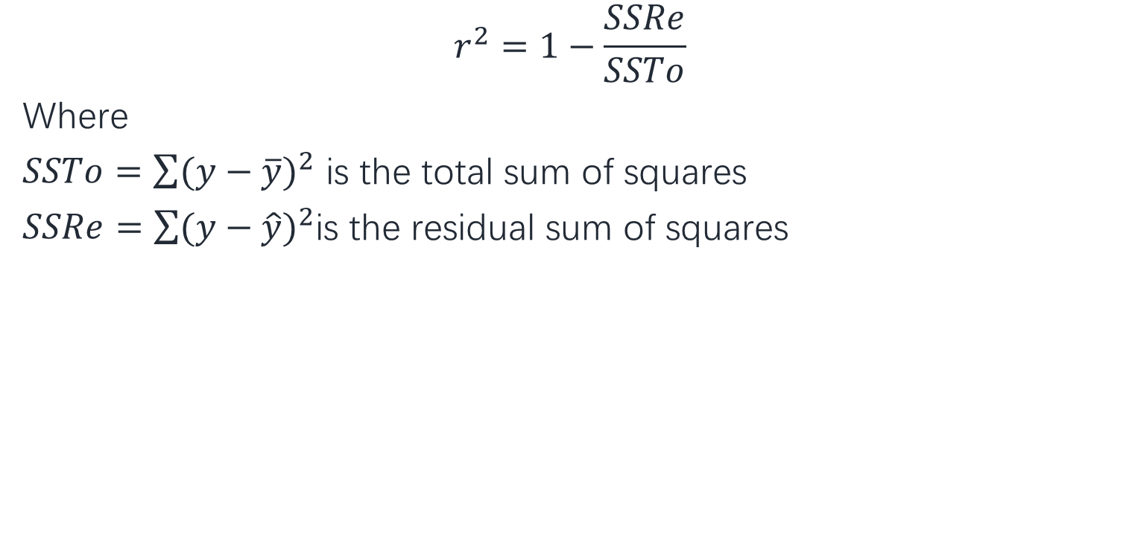
Coefficient of determination
$$r^{2}=1−\frac{SSRe}{SSTo}$$
Where
$SSTo=\sum{{(y−\overline{y})}^{2}}$ is the total sum of squares
$SSRe=\sum{{(y−\hat{y})}^{2}}$is the residual sum of squares
The value of $r^{2}$ is often converted to a percentage and interpreted as the percentage of variation in y can be explained by an approximate linear relationship between x and y

Slide 6
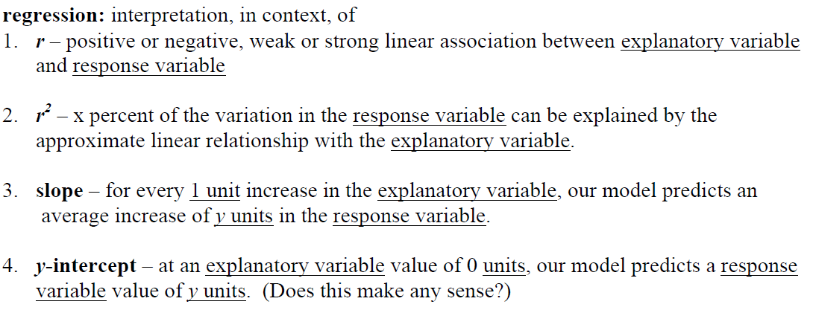
Interpretation

Slide 7
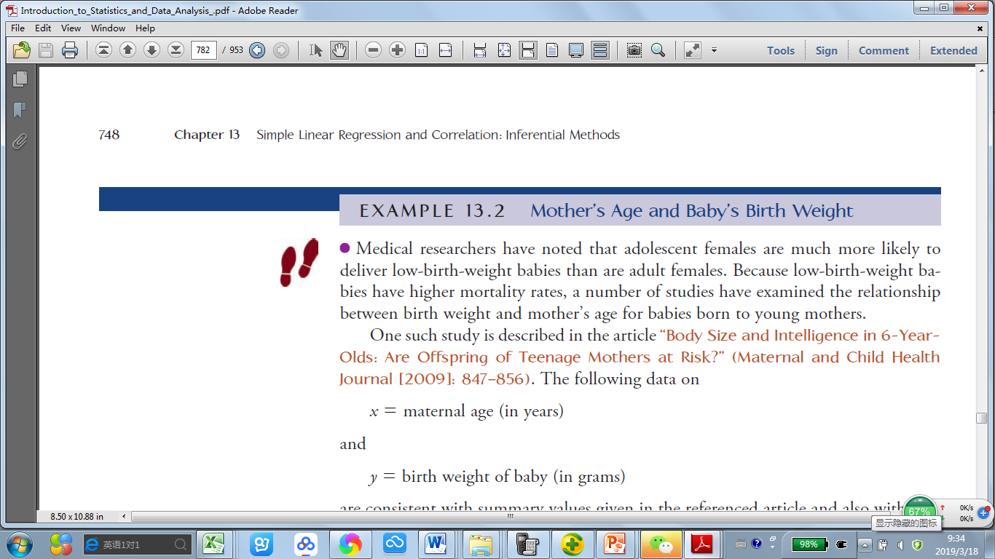
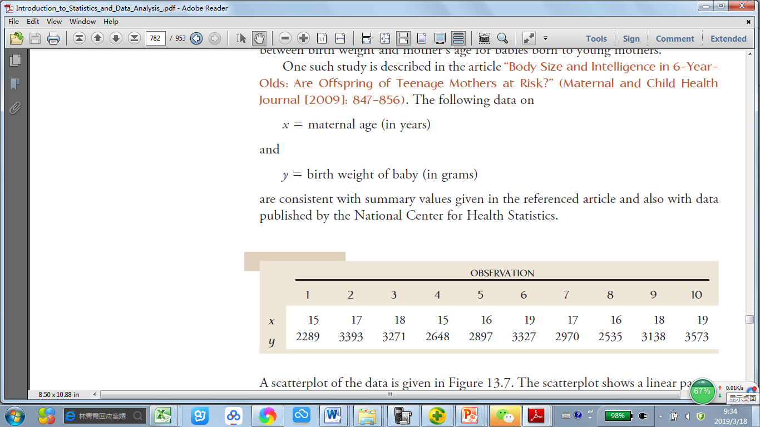

Slide 8
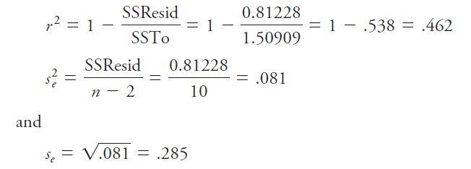
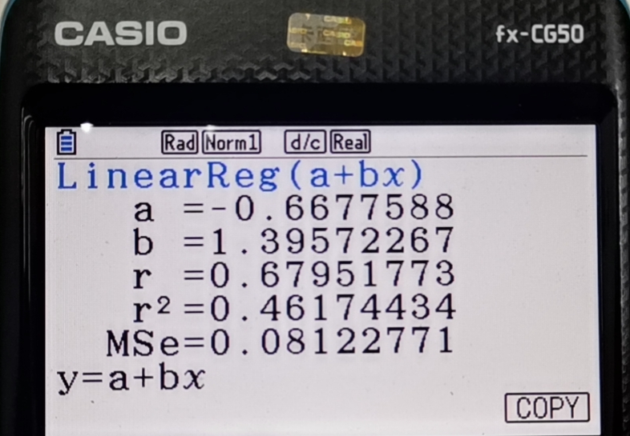

Slide 9
Simple linear regression model

Slide 10
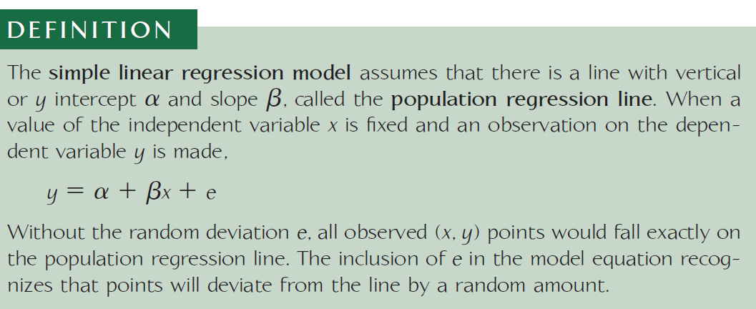

Slide 11
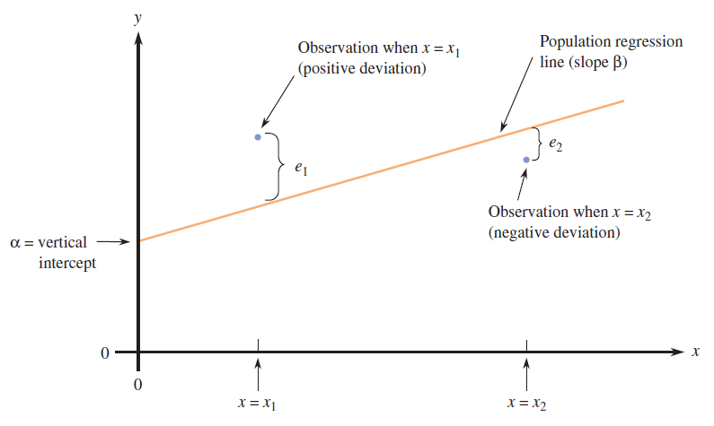

Slide 12
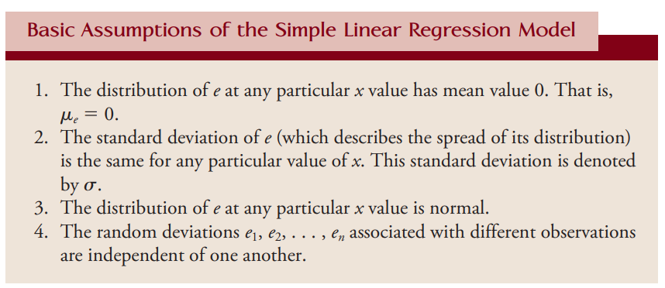

Slide 13
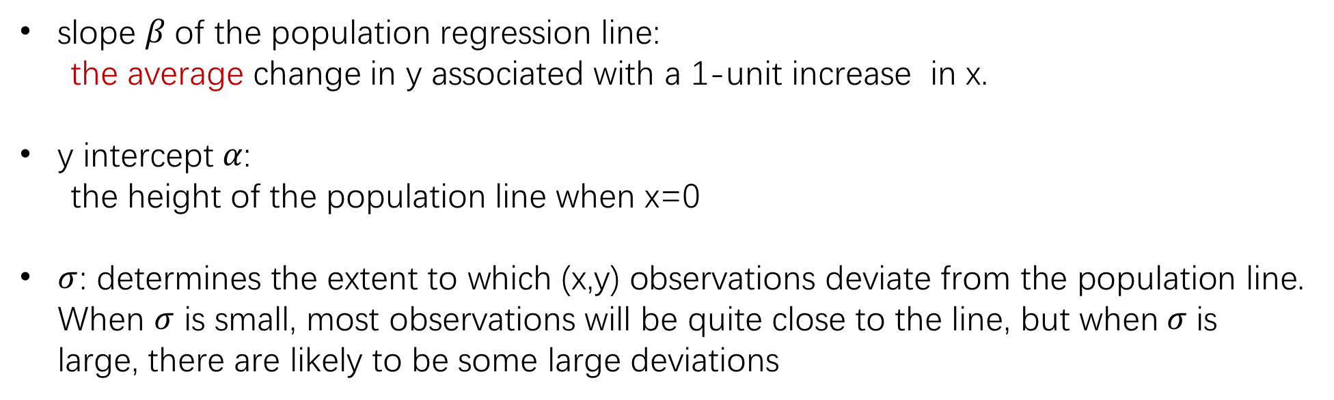
The properties of y at a fixed x value
For any fixed x value, what is the distribution of y?
y~N($α+βx, σ^{2}$)
slope $β$of the population regression line:
the average change in y associated with a 1-unit increase in x.
y intercept $α$:
the height of the population line when x=0
$σ$: determines the extent to which (x,y) observations deviate from the population line. When $σ$ is small, most observations will be quite close to the line, but when$σ$ is large, there are likely to be some large deviations

Slide 14
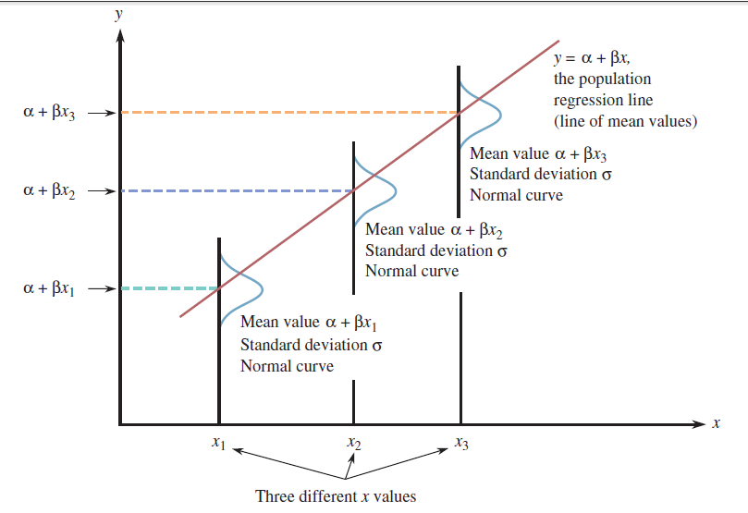

Slide 15
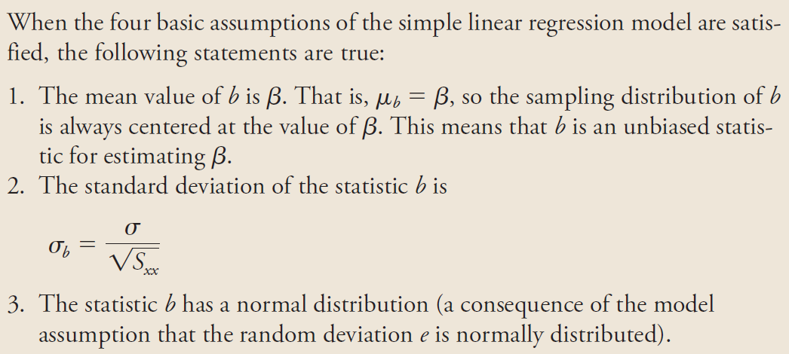
Properties of the sampling distribution of b

Slide 16
The true relationship between x and y is Linear
The data points must be Independent
For a particular value of the explanatory variable, the
responses are Normally distributed.
The boxplot of the residuals appears to be roughly symmetric and free of outliers.
4. Equal Variance: The standard deviation of errors must be
constant across values of x
Random
Experiment: treatments are randomly assigned
Observations: random sampling method

Slide 17
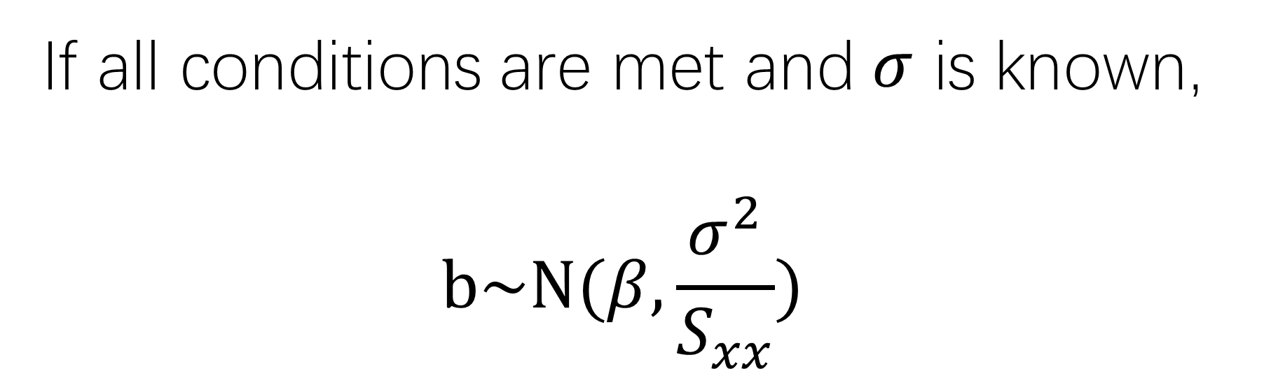
If all conditions are met and$σ$ is known, $$b\sim N(β, \frac{σ^{2}}{S_{xx}})$$

Slide 18
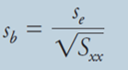
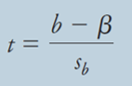
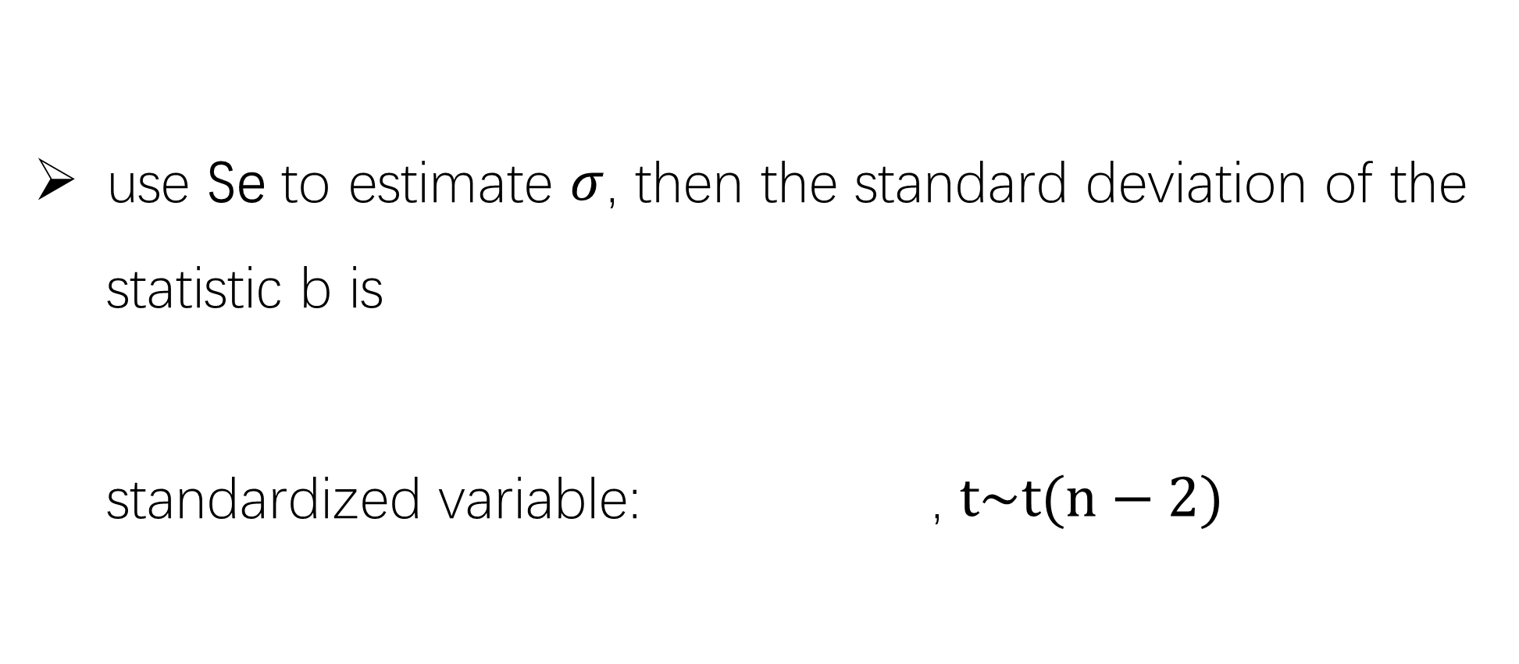

use Se to estimate $σ$, then the standard deviation of the statistic b is standardized variable: , $t\sim t(n−2)$
If all conditions are met but$σ$ unknown:

Slide 19
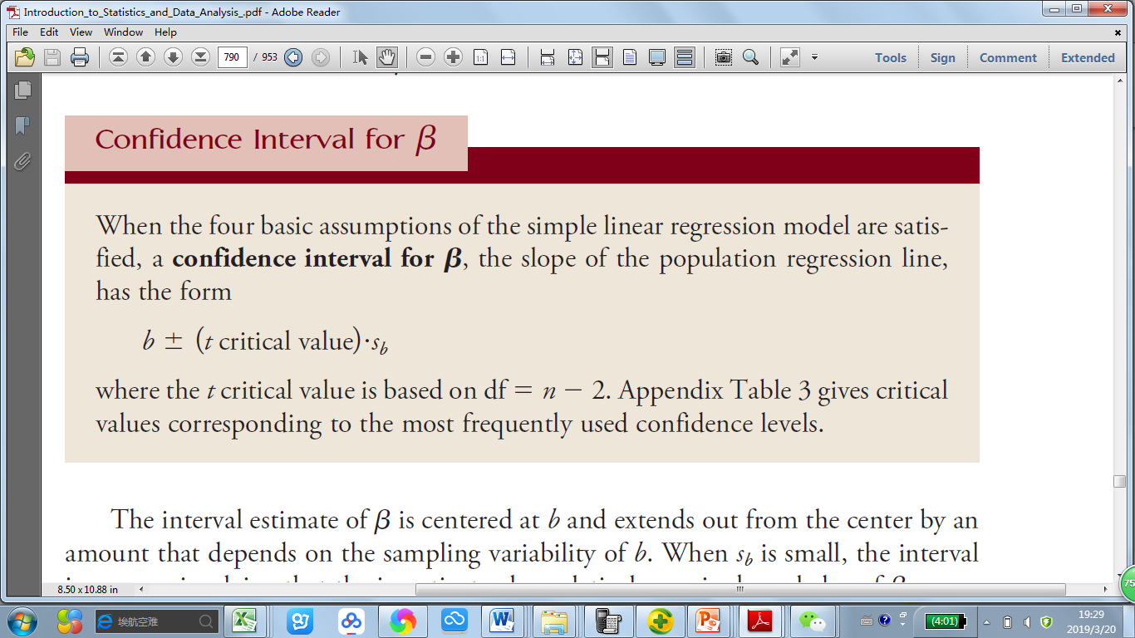

Slide 20

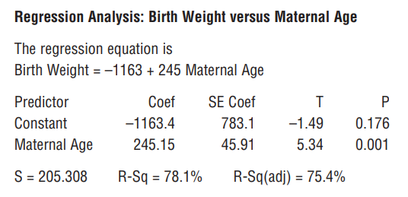
Read the regression table

Slide 21
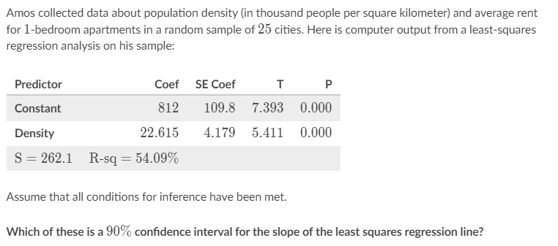
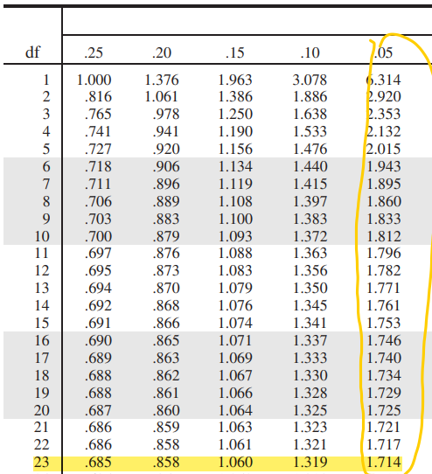
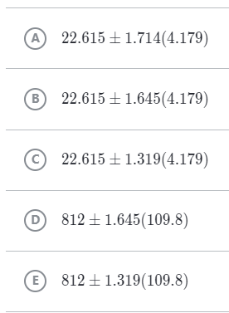

Slide 22
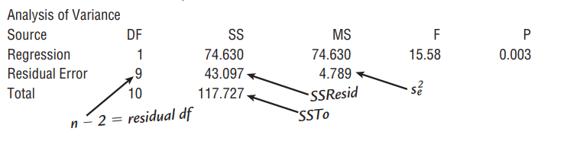
Read the regression table

Slide 23
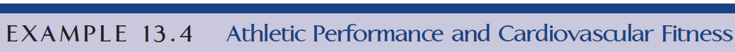
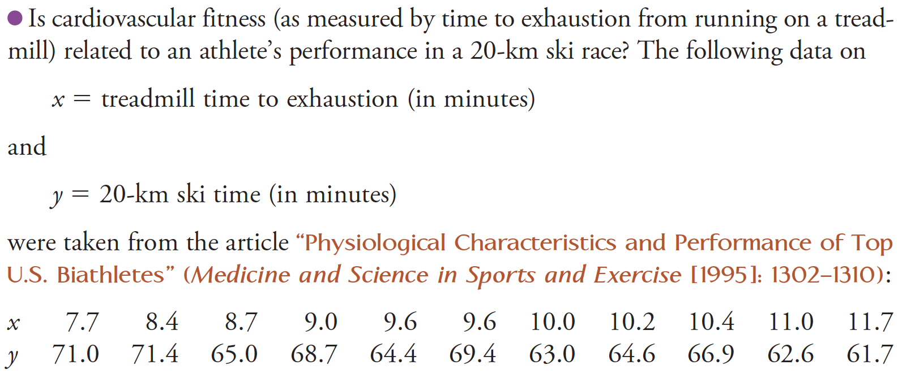

Slide 24
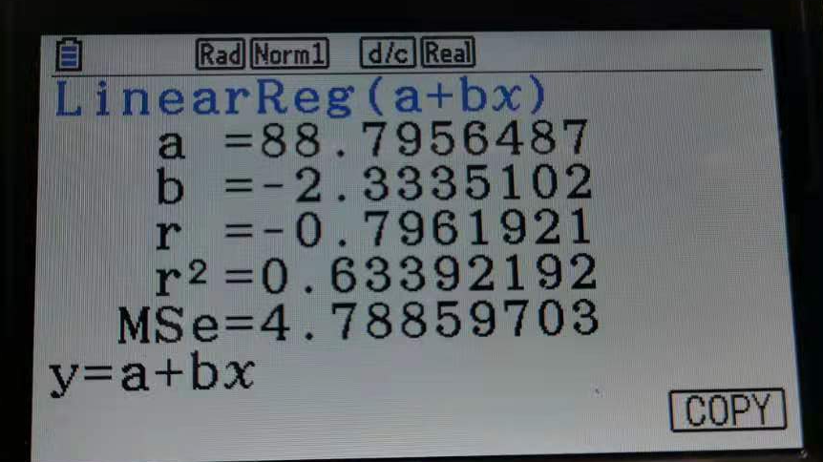
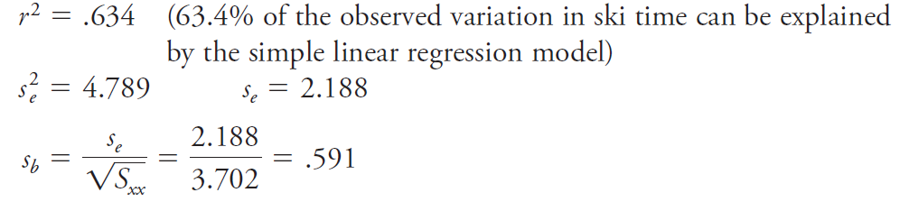
mean squared error

Slide 25
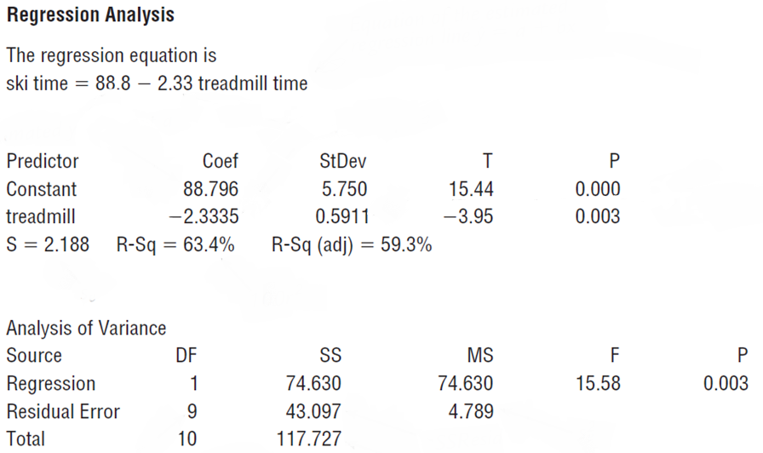

Slide 26
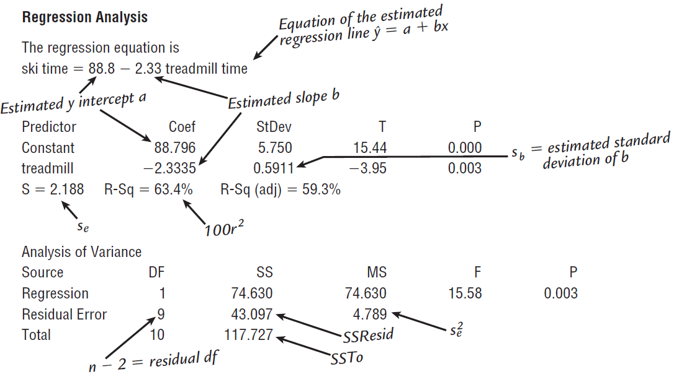
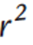


Slide 27
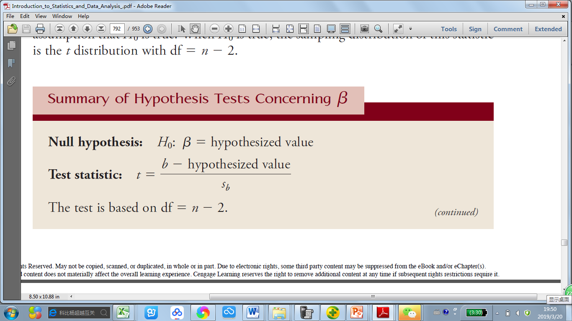
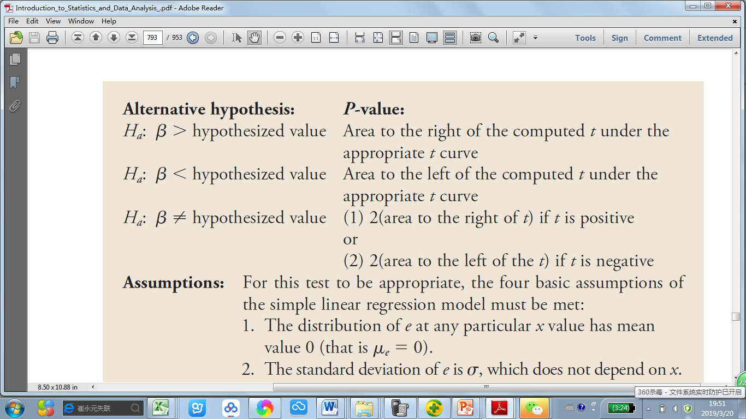

Hypothesis test concerning $β$

Slide 28
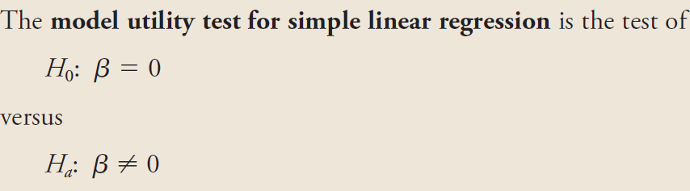
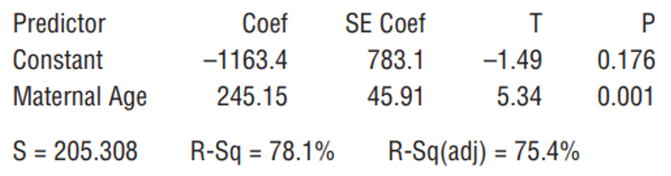
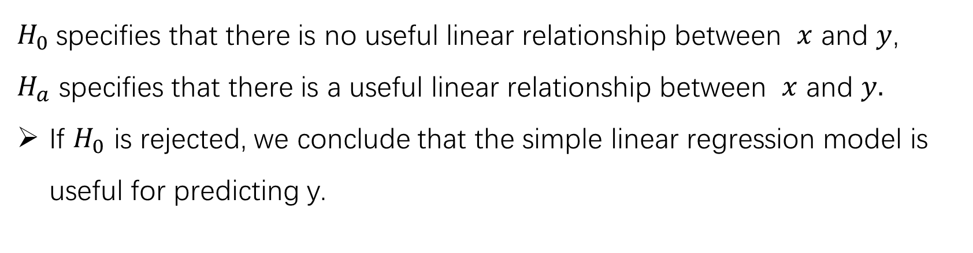
$H_{0}$specifies that there is no useful linear relationship between $x$ and $y$,
$H_{a}$ specifies that there is a useful linear relationship between $x$ and $y.$
If $H_{0}$ is rejected, we conclude that the simple linear regression model is useful for predicting y.

Slide 29
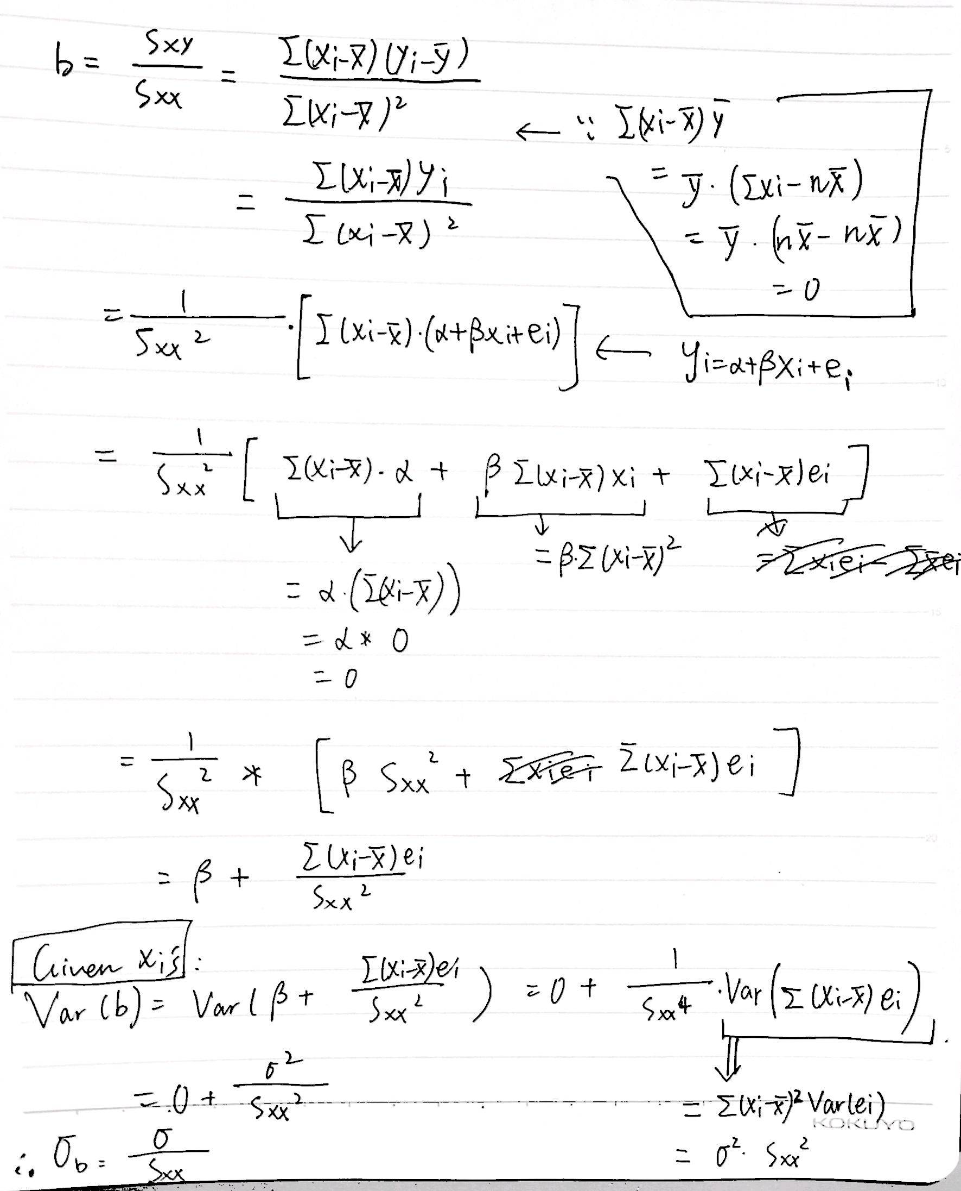
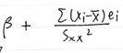
Var(b) SEb
You can also use the conclusion of the new expression of b,
, to prove that our point estimate of beta is unbiased!
NOT required

